Slide 1
ePoster guidelines
Thank you for accepting our offer to submit an ePoster for the 2026 ANZCA ASM.
This guide provides hints and tips about designing your poster’s structure and graphic design.
There are also some rules.

Slide 2
The rules
Your ePoster must be a single slide in portrait format, i.e. 9:16
The ePoster template provided is the preferred format; however, you may adjust the layout to suit your content, and a blank template is also provided.
We’re pleased to advise that short videos may be included in your ePoster.
You must declare on your ePoster whether, or not, there is a conflict of interest, i.e., personal, professional or business affiliation relevant to the presentation.
Sources of funding, equipment or other support must be given.
Refer to ‘Guidelines for sourcing images’ if you plan to include photos or imagery.
You should ‘Save-as’ or export your single slide as a PDF to upload.
The following hints and tips are just that; ultimately, it's up to you. You should not feel constrained by the following design guidelines.

Slide 3


An effective poster is…
Focused
Focus on your major findings.
A common fault is to try to cover too much.
Graphics
Let graphs and images tell the story.
Use text sparingly.
Ordered
Keep the sequence well-ordered and obvious.

Slide 4
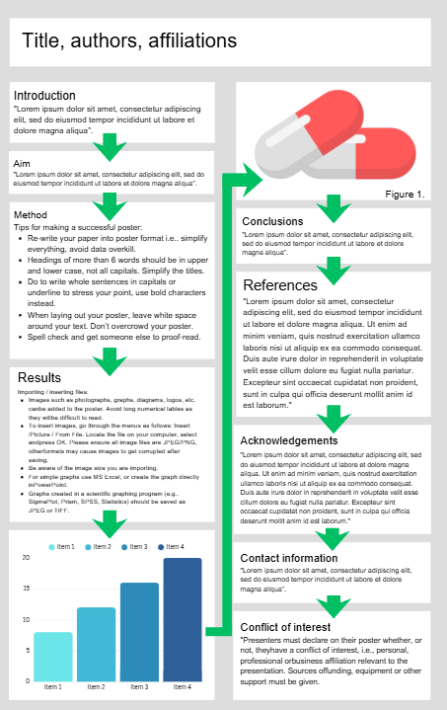
Start by designing your layout
Anyone viewing your poster should be able to easily understand the sequence of information.

Slide 5
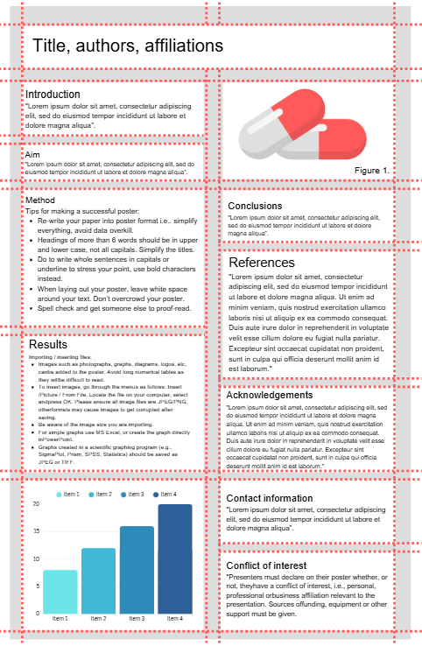
Layout design
The example shown here shows the sequence clearly, because it has been organized into a grid.
To enable grid lines navigate to the view tab in the ribbon and check the ‘Guides box’.

Slide 6

Tips on design
Choose one font and stick to it. Using a range of different fonts will make your poster difficult to read.
Choose a font that’s easy to read.
Use underlining and italics sparingly.
Light coloured text on a dark background will be easier to read on a monitor.
Remember that people reading your poster will be standing some way back from it or viewing it on a small screen. Once you’ve built yours, stand back from the screen to see how it reads from a distance.
This is harder to read than the adjacent example.
This is easier to read than the adjacent example.
This is impossible to read
This is impossible to miss

Slide 7
Refer to the ePoster template for an example

